Slide 1

Paralympics Games Analysis
Sports Industry
- Pratyush Majumdar

Slide 2
Objective
To provide an interactive and comprehensive overview of the Paralympics, showcasing key performance metrics, medal standings, athlete statistics, and historical trends.
This dashboard aims to deliver actionable insights to stakeholders, enabling them to track the progress of athletes, compare performances across various events, and explore the impact of different factors on the outcomes of the Paralympic Games.
210
2018

Slide 3
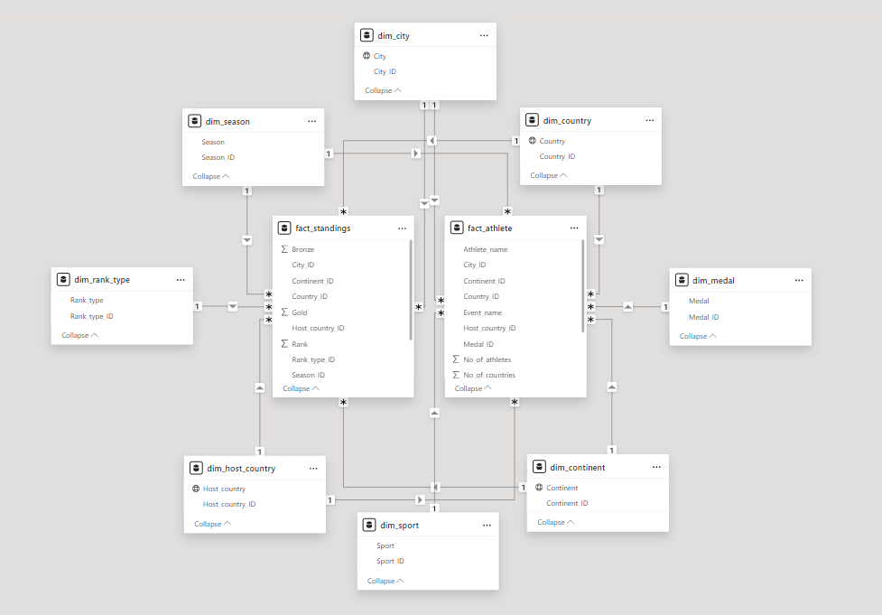

Data Model
210
2018

Slide 4
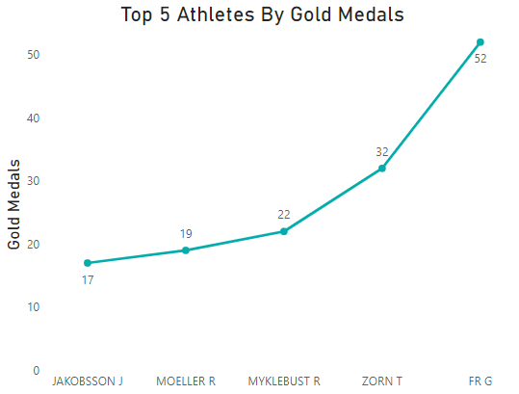
Insights
1) Identify the top 5 athletes with the highest number of gold medals.
Top 5 Athletes
Jakobsson J
Moeller R
Myklebust R
Zorn T
Fr G
210
2018

Slide 5
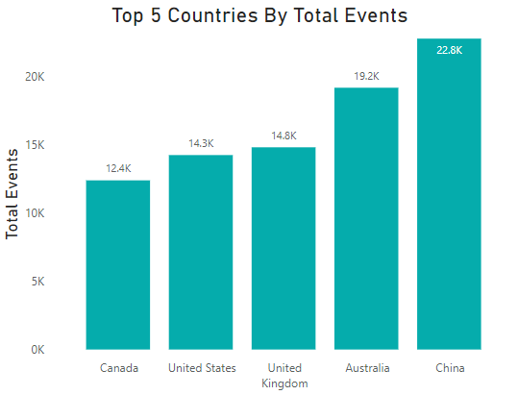
2) Identify the top 5 countries with the highest number of events for the year 2004.
Top 5 Countries
Canada
United States
United Kingdom
Australia
China
210
2018

Slide 6
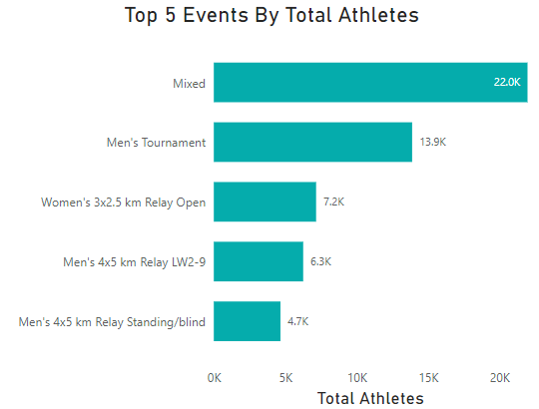
3) Identify the top 5 events with the highest number of athletes for winter season.
Top 5 Events
Men’s 4x5 km Relay Standing/blind
Men’s 4x5 Relay LW2-9
Womens 3x2.5 km Relay Open
Men’s Tournament
Mixed
210
2018

Slide 7
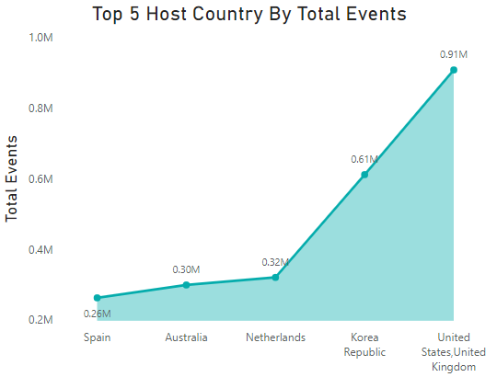
4) Identify the top 5 host countries with the highest number of events for summer season.
Top 5 Host Countries
Spain
Australia
Netherlands
Korea Republic
United States, United Kingdom
210
2018

Slide 8
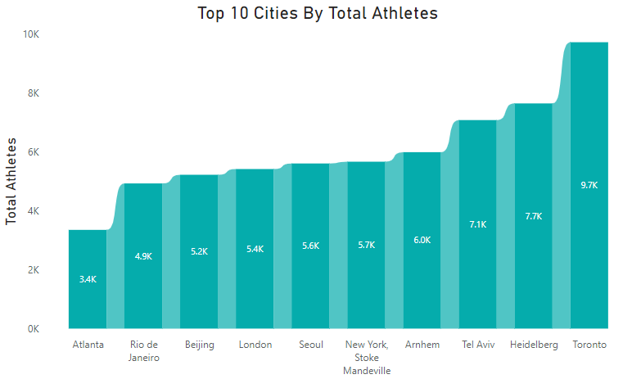
5) Identify the top 10 city with the highest number of athletes for archery sport.
210
2018

Slide 9
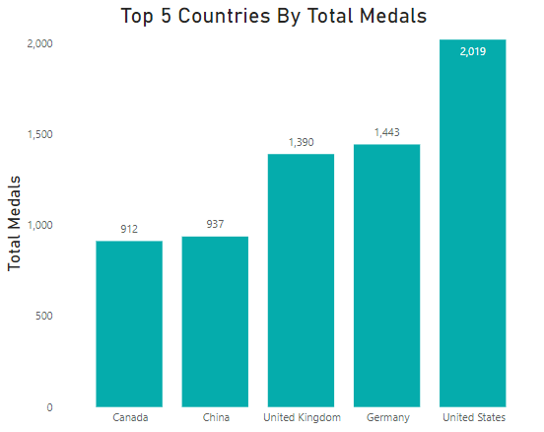
6) Identify the top 5 countries with the highest number of medals for rank type - sport.
Top 5 Countries
Canada
China
United Kingdom
Germany
United States
210
2018

Slide 10
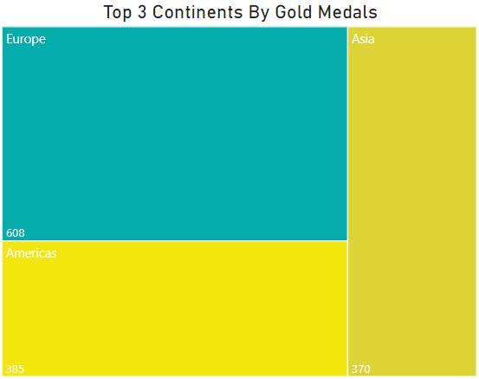
7) Identify the top 3 continents with the highest number of gold medals for swimming sport.
Top 3 Continents
Europe
Americas
Asia
210
2018

Slide 11
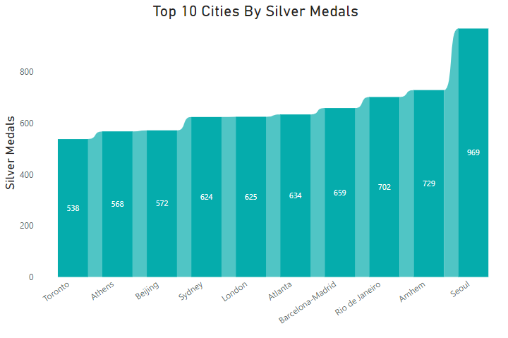
8) Identify the top 10 cities with the highest number of silver medals for summer season
210
2018

Slide 12
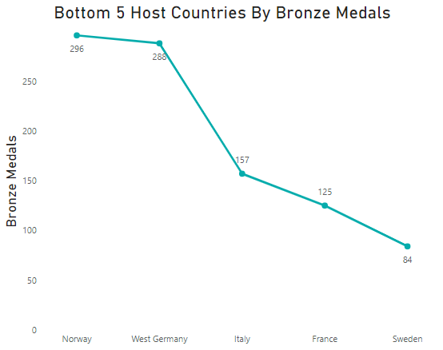
9) Identify the bottom 5 host countries with the lowest number of bronze medals from 1960 to 2000.
Bottom 5 Host Countries
Norway
West Germany
Italy
France
Sweden
210
2018

Slide 13
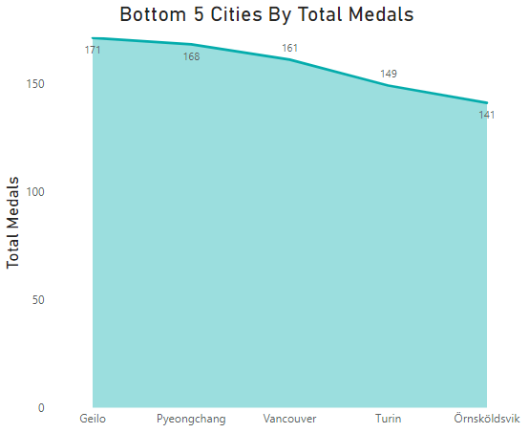
10) Identify the bottom 5 cities with lowest number of medals for winter season and rank type - overall.
Bottom 5 Cities
Geilo
Pyeongchang
Vancouver
Turin
Ornskoldsvik
210
2018

Slide 14
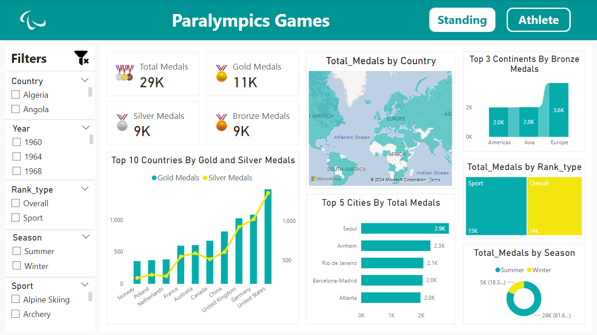
Dashboard
210
2018

Slide 15
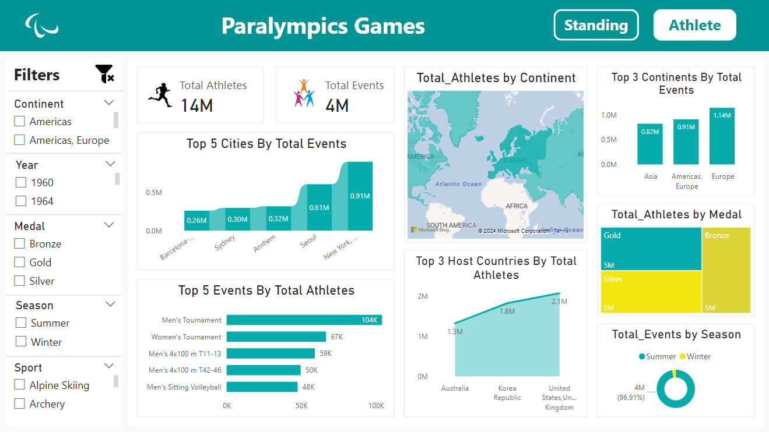
210
2018

Slide 16
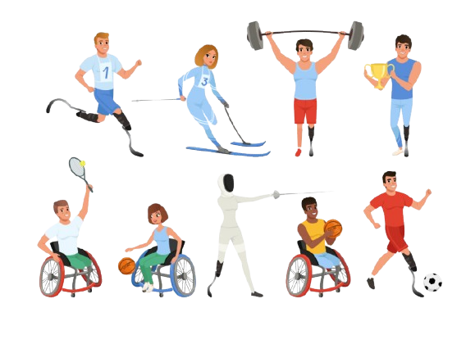
THANK YOU!
Let’s open the emotions of sport.

